Slide 1
Research Methodology – East and West
Prof. J.S.R. Prasad
University of Hyderabad

Slide 2
Upodghāta!
Research Methodology – Definition and Scope
Research in Eastern context
Commentary tradition
Technique of Dialectics
Western schools of thought
Indian research methods
Interdisciplinary outlook

Slide 3
Understanding the concept..
What is Research?
An intense search for truth is called – ' research '.
A careful investigation or inquiry specially through search for new facts in any branch of knowledge
Why does one requires to do Research?
For knowledge acquisition/growth
What is Research Methodology?
It informs us how to design a research study
It tells us how to use the methods
How does it happen?
- With unwavering devotion + untiring efforts
- Growth/development of human culture
What it results into?
Methods are part of methodology
For the first time, understandably, the word research had been used in literary context during 1577

Slide 4
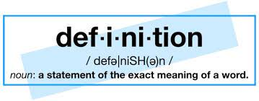
Definition
‘Re’ search - means searching again. Research is academic and scientific as well. Many dimensions of activities reflect Research in our daily life.
‘A careful investigation or inquiry specially through search for new facts in any branch of knowledge.’
Curiosity, Logical analysis and doubt are the key factors in research
“Doubt is often better than overconfidence, for it leads to inquiry, and inquiry leads to invention.” – Hudson Maxim

Slide 5
The term ‘Research’ was first used in 1577. The word research is originated from a French word (Researche) that we have known for about four hundred years.
The research that one conducts should be useful to the society.
Examples in mundane life:
News reporter – House wife – Chef – Pharma industry – Technological innovation

Slide 6
Types of Research
Descriptive vs Analytical
Applied vs Fundamental
Quantitative vs Qualitative
Conceptual vs Empirical

Slide 7
What is your motivation in Research?
1. Desire to get a research degree along with its consequential benefits
2. Desire to face the challenge in solving the unsolved problems
3. Desire to get intellectual joy of doing some creative work
4. Desire to be of service to society
5. Desire to get respectability

Slide 8
Methodology - प्रक्रिया
Observation
Induction
Deduction
Testing
Evaluation
समस्या
विषय
सङ्कोचः
कार्यप्रवृत्तिः
निरीक्षणम्
विषय
विश्लेषणम्
निगमनं
तथा
विषयव्यापृतिः

Slide 9
Research in Eastern context
Did they know what is a scientific composition?
Had they developed any method of the treatment of a scientific subject in an orderly manner?
Did they expound all the aspects of a given subject?
Was it their practice to reproduce the views of the past and/or the contemporary thinkers?
What was their style (of establishing their new thoughts and theories)?
Did the idea of making the subject matter intelligible as well as enjoyable? (Dr. W.K. Lele)

Slide 10
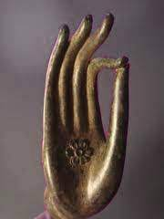
Terms in Sanskrit
Gaveṣaṇam, Anusandhānam, samśodhanam etc.
It is important to understand the ‘anubandha catuṣṭayam’ regarding the concept called research methodology.

Slide 12
Knowledge Process – ज्ञानप्रक्रिया
Knowledge
(ज्ञानम्)
Instinctive
(सहजसिद्ध)
Intellectual
(मेथासम्बद्ध)
1. Analysis (विश्लेषणम्)
2. Synthesis (समन्वयः)
Intuition
(अन्तर्दृष्टिः)

Slide 13
1. Commentary –
कात्यायनः, पतञ्जलिः, काशिकाकारः
2. Recension –
6. Popular exposition –
कथाप्रवचनपरम्परा
7. Re-creation –
भासनाटकचक्रम् इत्यादि ।
3. Redaction –
सिद्धान्तकौमुदी, लघु.सि.कौ.,
4. Adaptations –
हेमशब्दानुशासनम् (11th AD), रामायणं लोकभाषासु...
5. Translations –
Many from 14th C. onwards !
चान्द्रव्याकरणम् (4th AD), बौद्धानाम् अष्टाध्यायी

Slide 14
Panini has distinguished 4 classes of literature authorship and status as discourses of knowledge –
दृष्टम् (4.2.7 दृष्टं साम) । क्रुञ्चेन दृष्टं क्रौञ्चं साम। वासिष्ठम्। वैश्वामित्रम्
प्रोक्तम् (तेन प्रोक्तम् 4.3.101)
प्रकर्षेण उक्तम् प्रोक्तम् इत्युच्यते, न तु कृतम् । पाणिनीयम्। आपिशलम्। काशकृत्स्नम्।
उपज्ञातम् (4.3.115 विना उपदेशं ज्ञातम्) । पाणिनिना उपज्ञातं पाणिनीयमकालकं व्याकरणम्।
कृतम् (अधिकृत्य कृते ग्रन्थे 4.3.87, 116)
सुभद्रामधिकृत्य कृतो ग्रन्थः सौभद्रः । ययातिमधिकृत्य ‘यायातः’

Slide 15
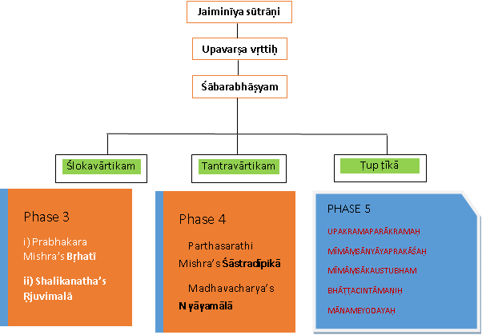
Commentary tradition – Mīmāṃsā

Slide 16

Dialectical Stages of Thought
Nyaya commentary tradition
Nyāya sūtram
Buddhist commentary tradition
Mādhyāmika kārikā - Nagarjuna
Nyāya bhāṣyam
Nyāya vārtikam
Nyāyavārtika tātparya ṭīkā
Nyāyavārtika tātparya ṭīkā pariśuddhi
Nyāyamañjarī
Ātmatattva Viveka, Bauddhadhikkāra
Pramāṇa samuccaya – Dinnaga
Pramāṇa vārtikam – Dharmakirti
Madhyamālaṅkāra – Santa Rakshita
Nyāya bhūṣaṇam – Bhasarvajna
सुगतो यदि सर्वज्ञः...

Slide 17
Observed facts alone do not constitute reality. The word 'Science' can have two connotations:
1. Material plane
2. Above material plane (spiritual plane)
But current science mostly worked for the 1st connotation.
Sanskrit study and research promotes spiritual progress & character building
‘knowledge and intellectual acumen should sub serve spiritual progress’ - Swami Anubhavananda

Slide 18
Western Schools of Thought
Cartesian Intellectualism (mind, matter, God and Humans)
Continental philosophy (intuition vs observation)
Analytical philosophy (formal logic & maths)
Rationalism (logic)
Empiricism (sense perception)
Philosopher’s Tooth – Francis Bacon!

Slide 19
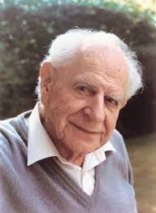
Influential Thinkers
Karl Popper (1902-1994) highly influenced the western science in recent times.
Book: ‘The logic of scientific discovery’ – Conjectures and Refutations – falsifiability.
Astrology, metaphysics, psychoanalysis are – pseudo sciences

Slide 20
Sun’s rising example vs falsifiability
Nyāyasūtra 4.1.50 says -
“that it was non-existent, is established by our understanding. It is only when a thing is non-existent that we can apply ourselves to the production of it by means of suitable materials. A weaver, for instance, sets himself to work for a web which is non-existent but which, he knows, he can make by means of threads.

Slide 21
Thought process – East
No amount of experimentation can ever prove me right; a single experiment can prove me wrong – Albert Einstein
न हि श्रुतिशतमपि शीतोऽग्निरप्रकाशो वा इति ब्रुवत् प्रामाण्यमुपैति। यदि ब्रूयात् शीतोऽग्निरप्रकाशो वा इति? तथापि अर्थान्तरं श्रुतेः, कल्प्यम् । प्रामाण्यान्यथानुपपत्तेः । (गीता. 18.66)
‘Surely, even a hundred Vedic texts cannot become valid if they assert that fire is cold or non-luminous! Should a Vedic text say that fire is cold or non-luminous, even then one has to assume that the intended meaning of the text is different, for otherwise (its) validity cannot be maintained..’

Slide 22
Murphy’s Law:
"Anything that can go wrong will go wrong".
प्राक्तनः पुरुषार्थोऽसौ मां नियोजयतीति धीः ।
बलादधःस्पदीकार्या प्रत्यक्षादधिका न सा ।।
Literature for research to counter-arguments

Slide 23
Indian Research Methods
Saṅgatayaḥ
Tantrayuktayaḥ
Laukika Nyāyāḥ
Anugamaḥ
Anubandhacatuṣṭam
Pramāṇāni
Adhikaraṇam
Are a few only quoted here.. But there are many more..

Slide 24
Interdisciplinary Outlook
West: Philosophy (-) Religion (-) Science (-) Ethics
East: Philosophy (+) Religion (+) Science (+) Ethics
Structural knowledge (vidyāsthānas)
Poets, authors (Pāṇini, Mallinātha, Śrīharṣa..)
पञ्च अन्यथासिद्धाः vis-à-vis Attribution of false reasons in a thesis
Bhartṛhari – प्रज्ञाविवेकं..
Suśruta – एकं शास्त्रम्..

Slide 25
Whether anyone would value my research?
ये नाम केचिदिह नः प्रथयन्त्यवज्ञाम्
जानन्ति ते किमपि तान्प्रति नैष यत्नः ।
उत्पत्स्यते तु मम कोऽपि समानधर्मा
कालो ह्ययं निरवधिर्विपुला च पृथ्वी ॥

Slide 26
References
Kothari C.R., Research Methodology – Methods&Techniques, New Age International Ltd. 2004
Lele W.K., Methodology of Ancient Indian Sciences, Chukhabma Surabharati Prakashan 2006
A. Ramaswamy Aiyangar (Ed.), Sanskrit Research and Modern Challenges, CIF 1997
Shukla Badrinath, Mathuri Pancalakshani, Rajasthan Hindi Granth Academy, Jaipur 1984
Kapoor Kapil, Tika Parampara: The Tradition of Interpretation, NMM News letter, Apr 2006
Jnanananda Swami, The Saint and the Scientist (available at https://www.saint-scientist.org/assets/the-saint-and-the-scientist.pdf)

Slide 27
एकं यदि भवेच्छास्त्रं ज्ञानं निस्संशयं भवेत् ।
बहुत्वादिह शास्त्राणां ज्ञानतत्त्वं सुदुर्लभम् ।।

Slide 28
As a laymen, we also do a bit of research in our daily life . For instance –
a news reporter strives hard to gather breaking news for a better circulation of his paper.
An executive chef in a hotel , employs all of his sensory knowledge to identify a best coffee to be served.
A chemist studies the composition and properties of chemicals in order to devise new medical formulas.
A house wife visits several shops to identify the pure ingredients to prepare a famous pickle like mango pickle!
The scope of all such research is meant to fulfil some material comfort or the other, but can not lead to to the ultimate truth!

Slide 29
- Doing research in Sanskrit, as per standard research methodology
- Doing research into the Indian (Sanskrit) research methodology

Slide 30
What exactly the western science does, to explore truth?
- it tries to fix the cause of this universe – observers and observed
- however, this is also the purpose of Indian philosophy (यतो वा इमानि..)
What are the means? PramaaNas!
Where it differs? At methodology level.

Slide 31
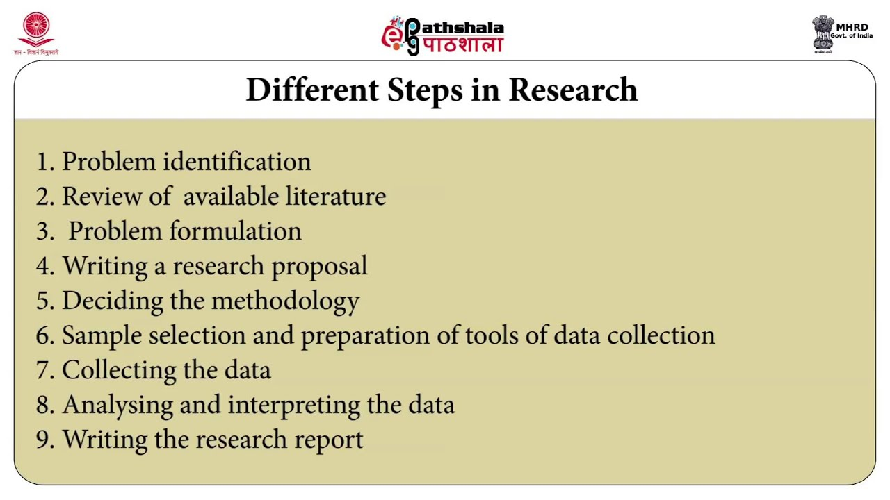

Slide 32
Structure
Formation of the topic
Hypothesis
Conceptual definitions
Operational definitions
Gathering of data
Analysis of data
Test, revising of hypothesis

Slide 33
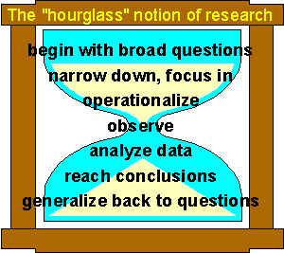
Research – Hour glass model
समस्या/संशोधनविषयकप्रश्नः
विषयसङ्कोचः – अनुशीलनम्
कार्यप्रवृत्तिः
निरीक्षणम्
विषयविश्लेषणम्
निगमनं प्रति...
विषयव्यापृतिः

Slide 34
Let’s consider a few examples..
क्षात्रधर्मोचितैर्धर्मैरलं शत्रुवधे नृपाः ।
किं नु वालिनि रामेण मुक्तो बाणः पराङ्मुखे ।।

Slide 35
यत्त्वगस्थिगतं पापं देहे तिष्ठति मामके ।
प्राशनात् पञ्चगव्यस्य दहत्वग्निरिवेन्धनम् ।।

Slide 36
Murphy’s Law:
"Anything that can go wrong will go wrong".
प्राक्तनः पुरुषार्थोऽसौ मां नियोजयतीति धीः ।
बलादधःस्पदीकार्या प्रत्यक्षादधिका न सा ।।
Literature for research to counter-arguments

Slide 37
An example from behavirol sciences
Hypothesis: identical twins can have different personalities because the environment influences personality.’
Evaluation: hypothetico-deductive method (also known as the method of "conjectures and refutations") of Karl Popper
In the field of behavioral genetics, the Minnesota Study of Twins Reared Apart—a well-known study of the genetic basis for personality—conducted research with twins from 1979 to 1999. In studying 350 pairs of twins, including pairs of identical and fraternal twins reared together and apart, researchers found that identical twins, whether raised together or apart, have very similar personalities.

Slide 38
Alternative hypothesis should consist –
testability (योग्यता)
simplicity (स्पष्टता)
scope (व्यापृतिः)
fruitfulness (प्रयोजनम्)
conservatism (आनुकूल्यम्)

Slide 39
Hypothesis would result in -
Collecting data
Analyzing information
Reporting results

Slide 40
There is a difference between ‘methods’ and ‘methodology’

Slide 41
Did we violate the sutrakaras..?
न हि श्रुतीनां शतमपि घटं पटयितुमीष्टे (वाचस्पतिमिश्रः)
झोन्तस्य कोर्थः
झोन्तस्य झोन्त इत्येवार्थः ।
अझोन्तस्यापि झोन्तत्वे घटः किं न पटायते?
किं गवि गोत्वम्, उत अगवि गोत्वम्?
गवि गोत्वं भवदिष्टं चेत् गव्येव स्यात् ।
अगवि गोत्वं भवदिष्टं चेत् भवति भवत्यपि तुल्यं गोत्वम्!
न खलु वै सूत्रकारनियोगभयात्पदार्थाः स्वधर्मं हातुमर्हन्ति । (भासर्वज्ञः)

Slide 42
Some important western schools of thought
Cartesian Intellectualism (mind, matter, God and Humans)
Continental philosophy (intuition vs observation)
Analytical philosophy (formal logic&maths)
Rationalism (logic)
Empiricism (sense perception)

Slide 43
Approaches – East & West
शास्त्रम् vs Science?
or
Science vis-a-vis शास्त्रम्?

Slide 44
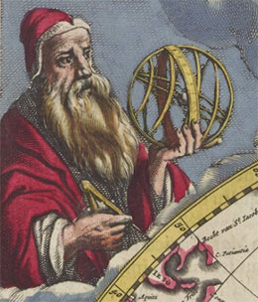
Science Vs Religion
Cladius Ptolemy (139 A.D.) inspired by Aristotle established an idea of geocentric world
This theory dominated for about 1500 years

Slide 45
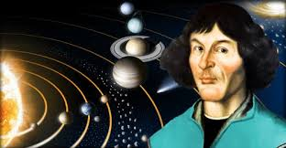
Nicolaus Copernicus (1473-1543) refuted Ptolemy and proposed a new heliocentric theory
Dedicated his work - ‘On the Revolutions of the Heavenly Spheres’ to Pope III.

Slide 46
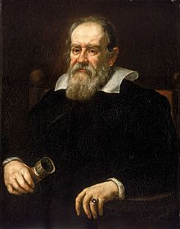
Galileo Galilli (1564-1642) endorsed Copernicus. Invented telescope.
Taiko Bruno – supported; Copernicus, burnt to death; John Kepler – met with the same fate

Slide 47
In ancient times, logic and experimentation were against the ‘belief’ (religion) in the west..
Whereas, logic is the basis of Indian philosophy.

Slide 48
Example in Nyayashastra -
- in Nyaya view, the formal approach in proposing, reviewing or criticizing a theory is threefold - 1. Uddeśa 2. Lakṣaṇa and 3. Parīkṣā.
- testability through 1. Over pervasion 2. Non-pervasion and 3. Impossibility.
- paraarthaanumaanam (inductive&deductive)

Slide 49
Research Statements
अथातो ब्रह्मजिज्ञासा – वेदान्तदर्शनम्
अथातो धर्मजिज्ञासा – मीमांसादर्शनम्
अथ योगानुशासनम् – योगदर्शनम्
अथ त्रिविधदुःखात्यन्तनिवृत्तिरत्यन्तपुरुषार्थः – साङ्ख्यदर्शनम्
अथातो धर्मं व्याख्यास्यामः – वैशेषिकदर्शनम्
प्रमाण-प्रमेय-संशय...निश्श्रेयसाधिगमः – न्यायदर्शनम्
अथातो सर्वभूतचिन्ताशरीरं व्याख्यास्यामः – चरकसंहिता

Slide 50
Some scientific insights
लोष्ट: क्षिप्त: बाहुवेगं गत्वा नैव तिर्यग् गच्छति नोर्ध्वमारोहति, पृथिवीविकार: पृथिवीमेव गच्छति आन्तर्यत: (महा.)
संयोगाभावे गुरुत्वात्पतनम् । (वै.सू.5.1.7)
प्रयत्नविशेषान्नोदनविशेषः (वै.सू.5.1.9)

Slide 51
स॒वि॒ता । य॒न्त्रैः । पृ॒थि॒वीम् । अ॒र॒म्णा॒त् । अ॒स्क॒म्भ॒ने । स॒वि॒ता । द्याम् । अ॒दृं॒ह॒त् । अश्व॑म्ऽइव । अ॒धु॒क्ष॒त् । धुनि॑म् । अ॒न्तरि॑क्षम् । अ॒तूर्ते॑ । ब॒द्धम् । स॒वि॒ता । स॒मु॒द्रम् ॥ (Rgveda 10.149.1)
“The sun has tied Earth and other planets through attraction and moves them around itself as if a trainer moves newly trained horses around itself holding their reins.”
यदा ते हर्यता हरी वाव्र्धाते दिवे-दिवे । आदित ते विश्वा भुवनानि येमिरे ।। (Rgveda 8.12.28)
“All planets remain stable because as they come closer to sun due to attraction, their speed of coming closer increases proportionately.”

Slide 52
How a title should be?
नामकार्यं नाटकस्य गर्भितार्थप्रकाशकम् ।। ६.१४२ ।।यथा रामाभ्युदयादिः। (सा.द.)
नाम्ना कर्मानुरूपेण ज्ञायते गुणदोषयोः ।
काव्यस्य पुरुषस्येव व्यक्तिः संवादपातिनी ॥ ३८ ॥ (औ.वि.च.)
काव्यस्य कर्म औचित्यं तेन नाम्ना पुरुषस्येव गुणदोषव्यक्तिः संवादिनी ज्ञायते । भवः (भवति जगदस्मात्) – हरः (हरति, विनाशयति जगत्)

Slide 53
(1. Anusandhāna Paddhati (1969) by Prof. Bhagirath Prasad Tripathi and 2. Anusandhāna pravidhi prakriyā (Ed. 1986) by Dr. Nagendra) these were mostly translations of the western books into Sanskrit but not vice versa. Few books like, Research in Sanskrit (1993) by Prof. K.V. Sarma, Splendor of Sanskrit Research (2015) by Dr. Satyavrat Varma, are a mere resource on references and bibliographies and talks about textual criticism, respectively. Elements of Sanskrit Research Methodology (1992) by Prof. Kesab Chandra Dash, Saṃskṛt śodh pravidhi (2014) by Prof. Prabhunath Dwivedi ‘just’ address the dissertation writing needs for Sanskrit students. Research in Literature and Language: Philosophy, Areas and Methodology (2018) authored by Dr. H.V. Deshpande - Methodology of Ancient Indian Sciences (2006)

Slide 54
Thank you!

